Slide 1

Damage Monitoring in Repaired
CFRP Composites Using Digital Image Correlation
AZ Space Grant Consortium 2019
Tempe, AZ - April 12 - 13, 2019
Rachael Bradshaw and Joseph Gentile
Faculty Mentor: Dr. Wahyu Lestari,
Department of Aerospace Engineering
Embry-Riddle Aeronautical University, Prescott, AZ, USA

Slide 2

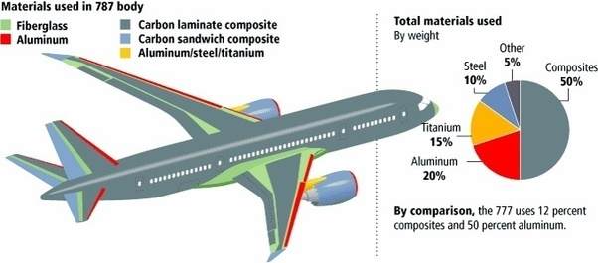
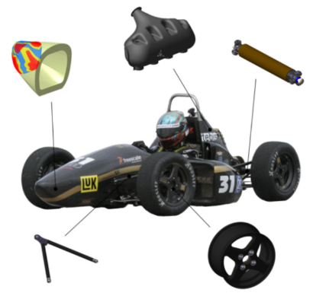
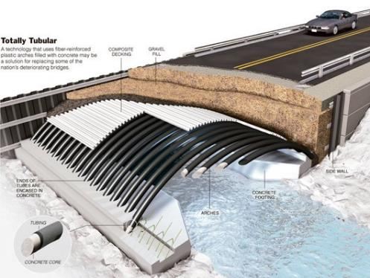

Motivation
Everyday Use
Aerospace
Carbon Fiber Helmet. Digital Image. Pitaka. 9 Mar 2017
Composites in the Aerospace Industry. Digital Image. Quora. 31 Jul 2016
Automotive
Civil
Carbon fiber arches for bridges. Digital Image. Carbon Fiber Gear. 2013
Complex Composite-Parts with CATIA. Digital Image. Technical University of Munich.
Notes:
Fiber reinforced polymer composites are revolutionizing the design of large, high-performance structures in the aerospace, marine and power generation industries -- due to their advantages in areas such as corrosion resistance, specific strength and ability to be customized. Examples on slide
It is important to understand the stress distribution of damaged structures before and after repair, which ultimately determines the residual strength and life of the structures. For example, if a bonded repair fails, the structure must still be able to maintain the minimum required strength.
The increasing use of CFRP composites for aircraft primary structural components requires a better understanding of their behavior, especially in the presence of damages. It is essential that the behavior of a repaired carbon composite components is known to improve the life of each repair in the design that it is a part of.

Slide 3
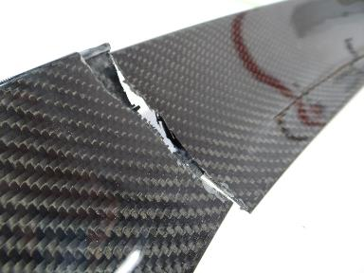
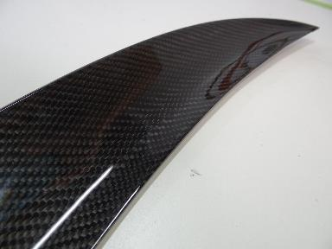
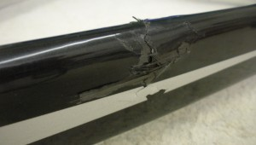
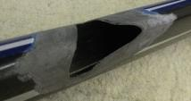
CFRP Composite Failure
Carbon
Fiber
Reinforced
Polymer
Carbon Fiber Repair. Digital Image. Carbon Fiber 500, 2019
Structural Carbon Repair. Digital Image. The Carbon Doctor, 2019
Notes:
Some examples of damages that are seen in the aerospace industry are complete breakage, or crack and impact damage.
There are many repair methods available, and it’s questioned if the repairs truly provide the same strength as if the component was undamaged.

Slide 4
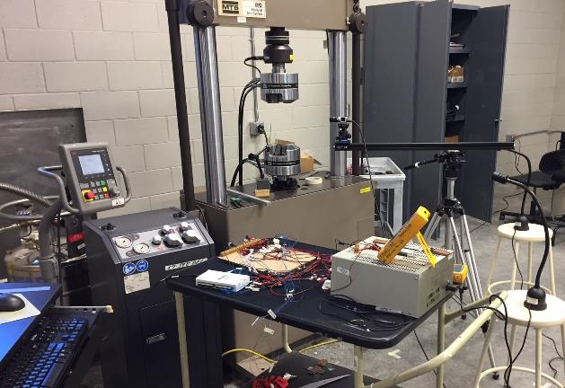
Objective
To demonstrate the reliability of repaired CFRP composites using a digital image correlation (DIC) technique.
To perform experimental tests to identify stress distribution in repaired CFRP composites
  Test pre-damaged samples and pristine samples
Test setup
Notes:
Our objective is to use DIC to demonstrate the reliability of repaired composite samples
We do tensile testing to break the sample, while simultaneously gathering photos to be analyzed via DIC

Slide 5
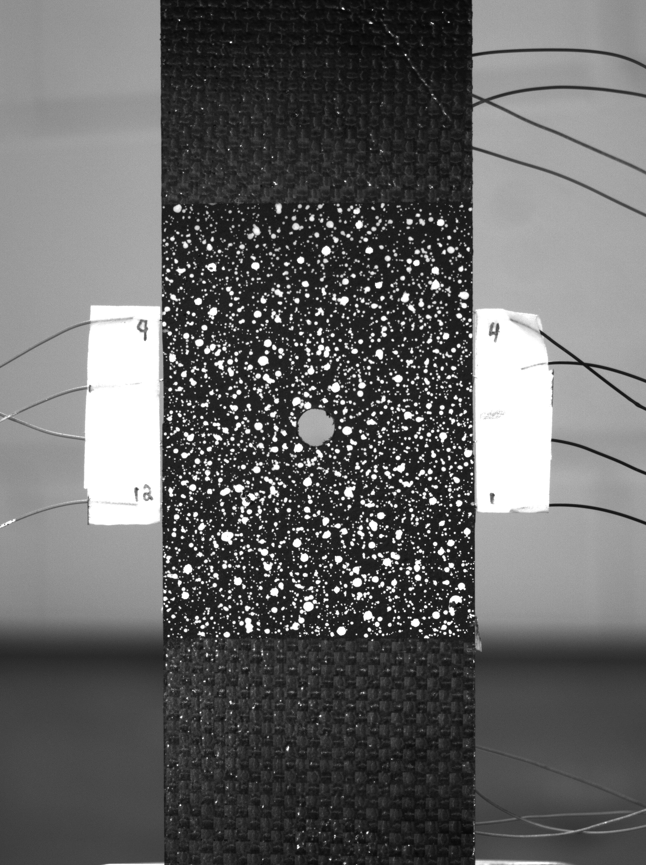
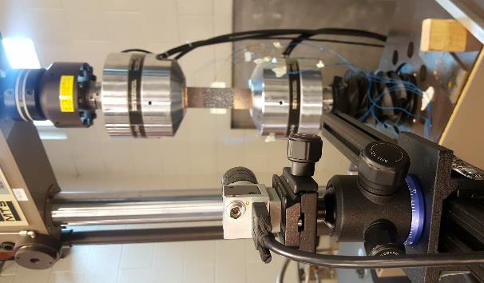
Digital Image Correlation (DIC)
Ncorr open source 2D digital image correlation MATLAB based code
  Digital images ➔ 2D strain fields
Camera setup
Sample photograph
Notes:
DIC is a non-contact optical measurement tool that provides displacement and strain maps of deformed surfaces
Utilize Ncorr, an open based MATLAB software to perform all the DIC algorithms. Process the images and generate the strain fields.
Camera Basler Ace acA3800-14um 10 MP and Basler Lens C125-2522-5MP F2.2 f25mm

Slide 6
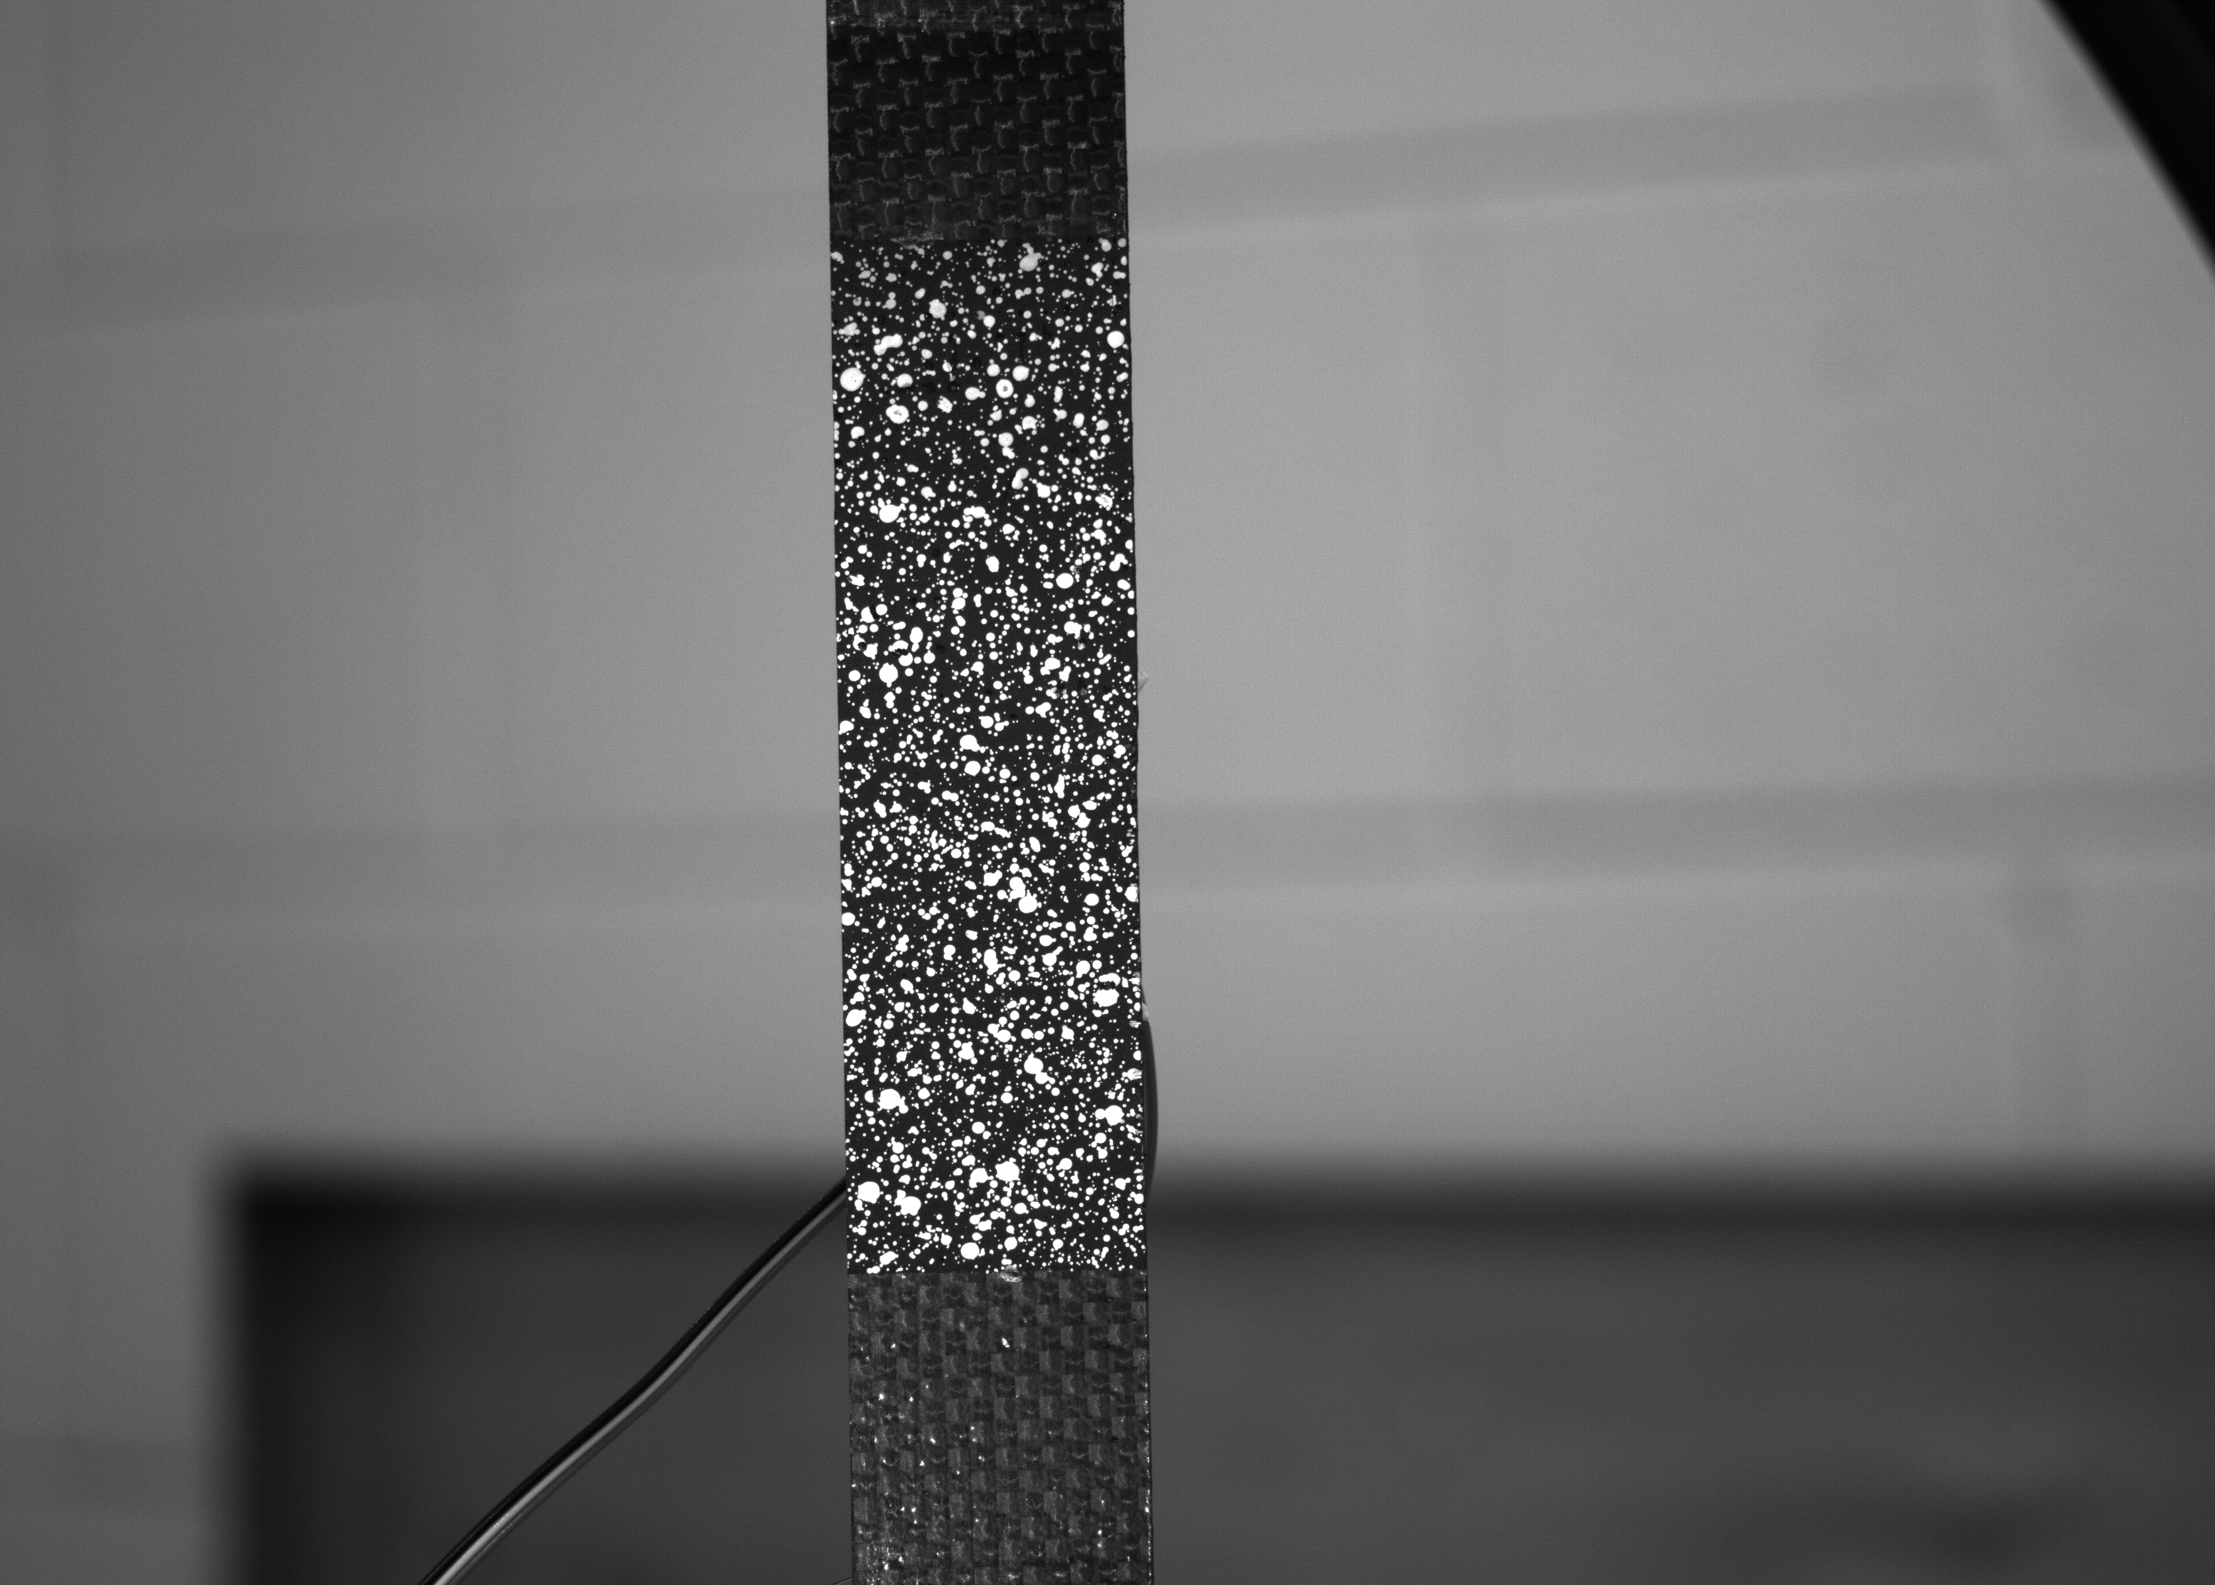
Sample Preparation
Specimen Dimensions: 11 in x 1.75 in (L x W)
  Fiber: Carbon AS-4C plain weave, [0/45/0/45/0]_{S}
  Matrix: Epoxy/hardener (TenCate BT250 E-6 resin)
  Curing Cycle: 2 h @ 260°F
Speckle pattern
  Paint the area of interest with a black background in several layers
  Spray white paint over the area to create a speckle pattern
Notes:
Vacuum bagged before cured
Plate is tabbed and cut into beams
Speckle: Start with applying a black primer base coat until the carbon pattern is no longer visible. Next, by holding the spray can ~1.5ft away from the sample, I use a white primer to apply a fine speckled pattern
Ncorr literally tracks the movement of each speckle, good quality speckles affect results:
not too big, high contrast, even/random distribution

Slide 7
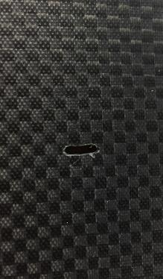
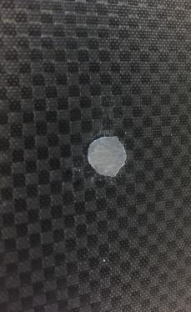
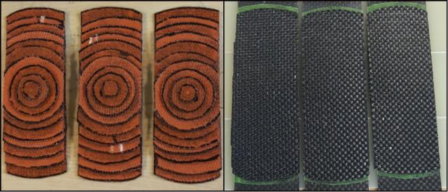
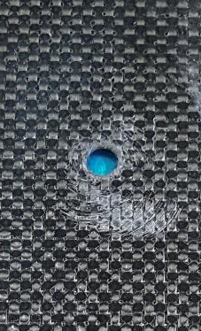
Repair Method
Stages of repair: (a) Damage is identified
(b) Hole is made to remove damaged composite
(c) Fill the hole with epoxy resin
(d) Layer patches on top of the damaged area
(a)
(b)
(c)
(d)
Notes:
Damage = crack in our case
Cut out damaged area to ensure that hidden damages are removed
Fill hole with epoxy resin
For small sample: layer patches on top of the damaged area
Same # of plies and orientation as the original layup
Would normally do a 2 sided repair, but we had to do one sided because the DIC required a smooth surface to produce accurate results

Slide 8
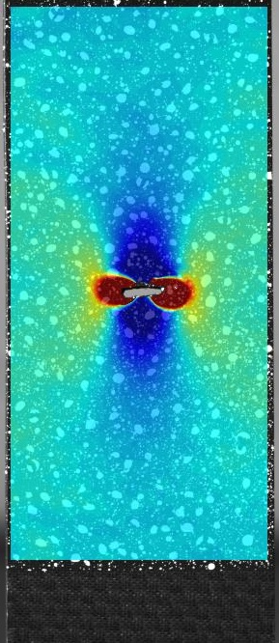
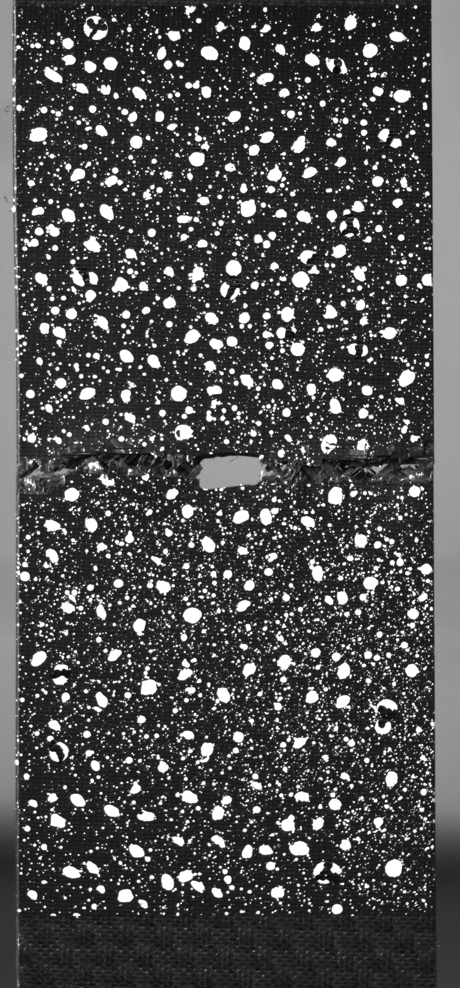
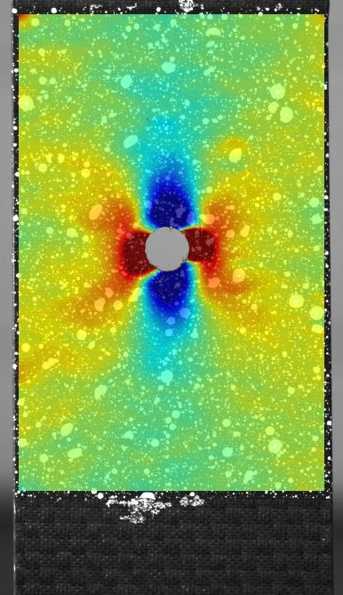
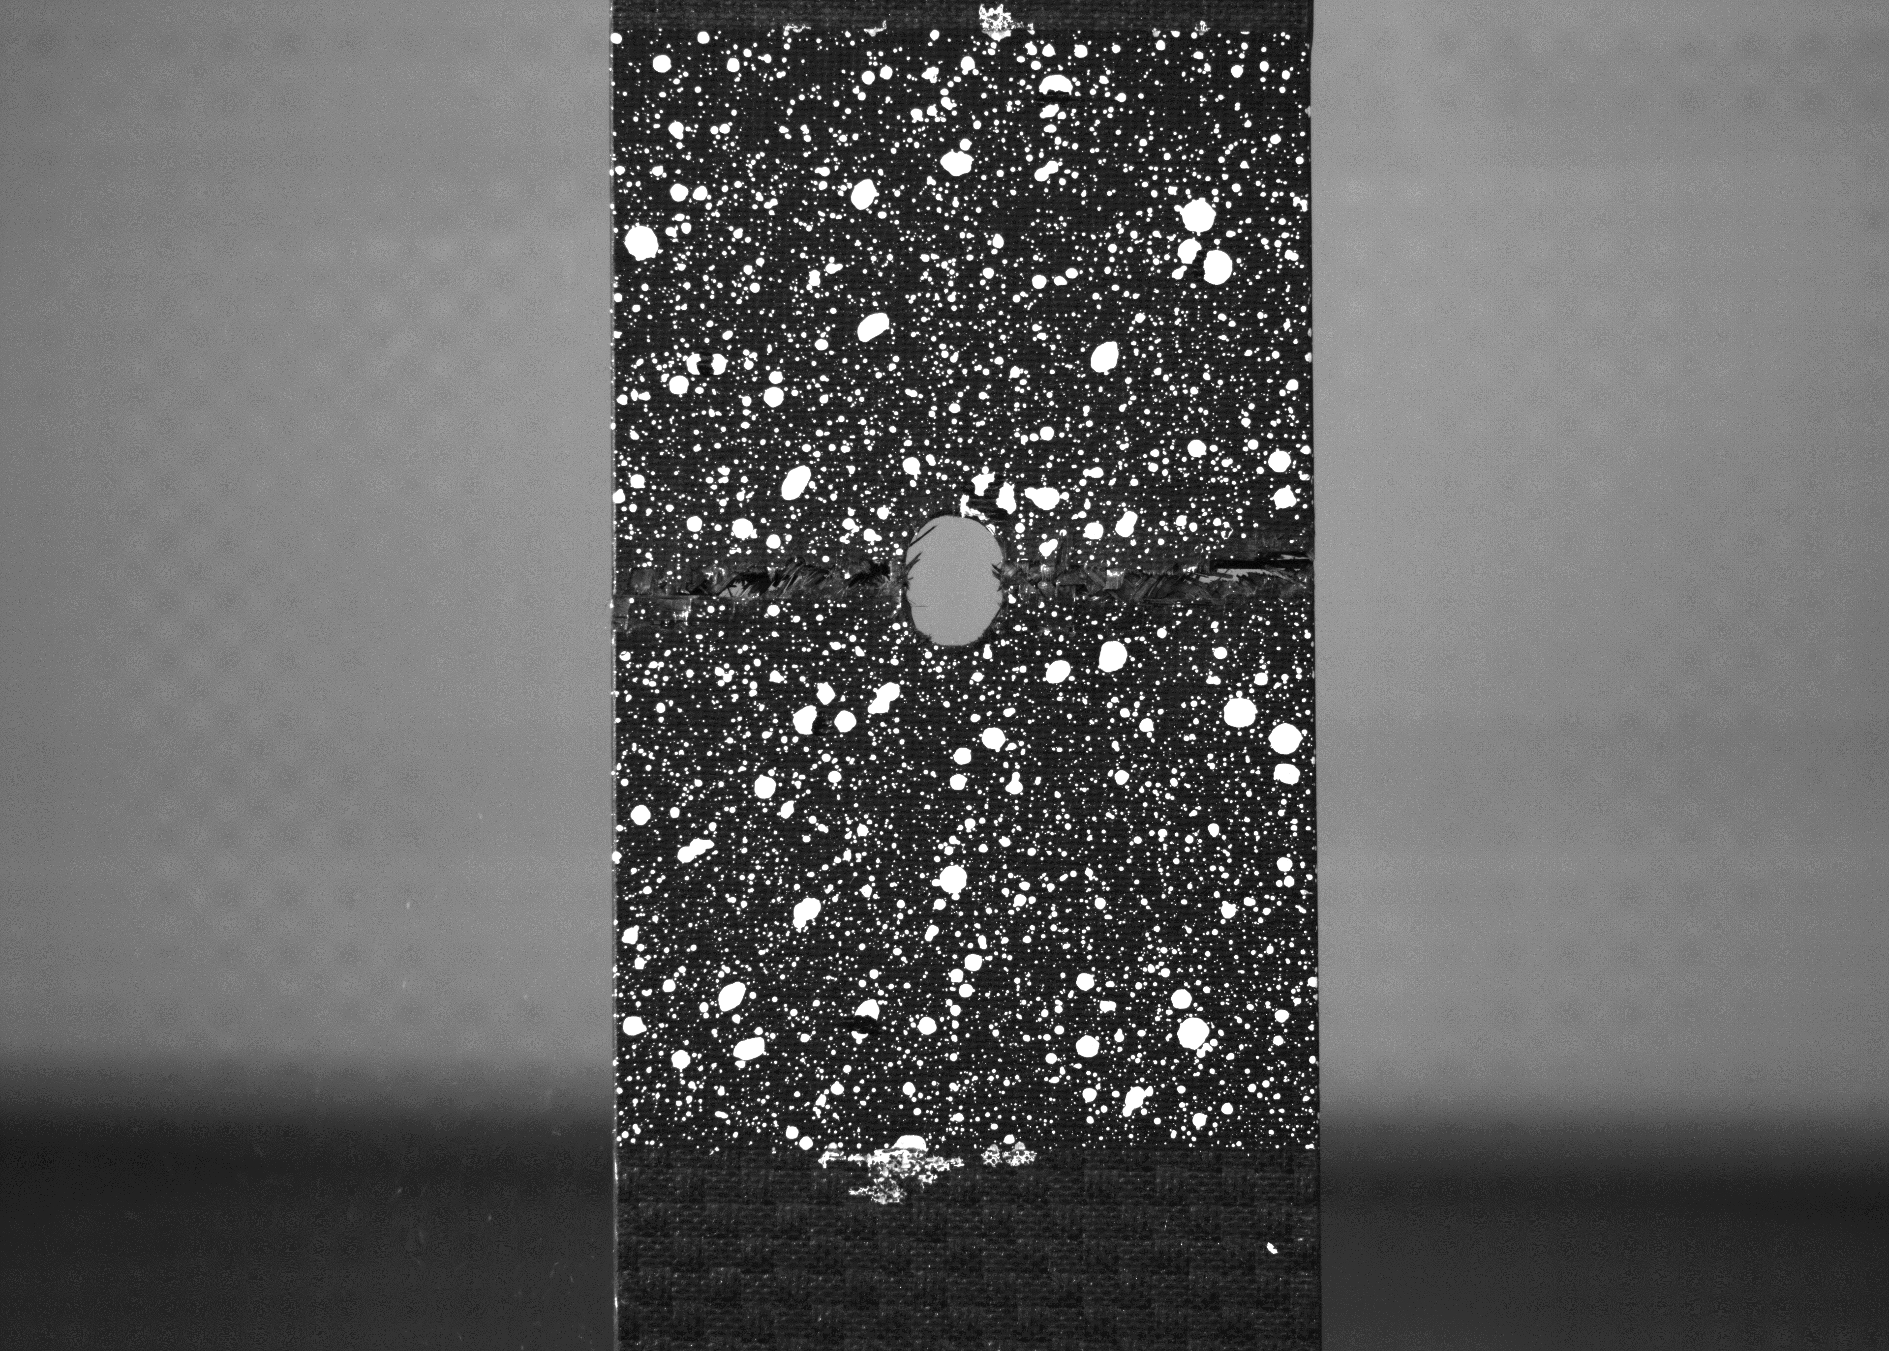
DIC Results (1/2)
Cracked Sample
Sample with Hole
Failure at 7,496 lb_{f} (applied load)
Failure at 7,825 lb_{f} (applied load)
Notes:
DIC and load data show us that a same sized crack and hole have the same stress distribution and failure loads. Which means a small crack in a structure effectively acts as a hole—which is why it is important to repair

Slide 9
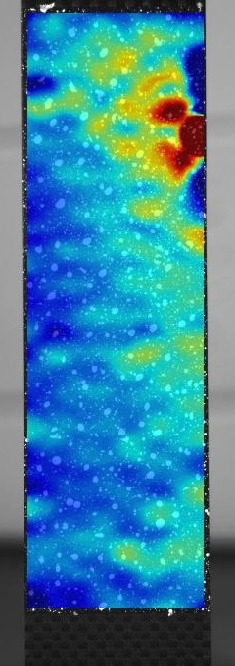
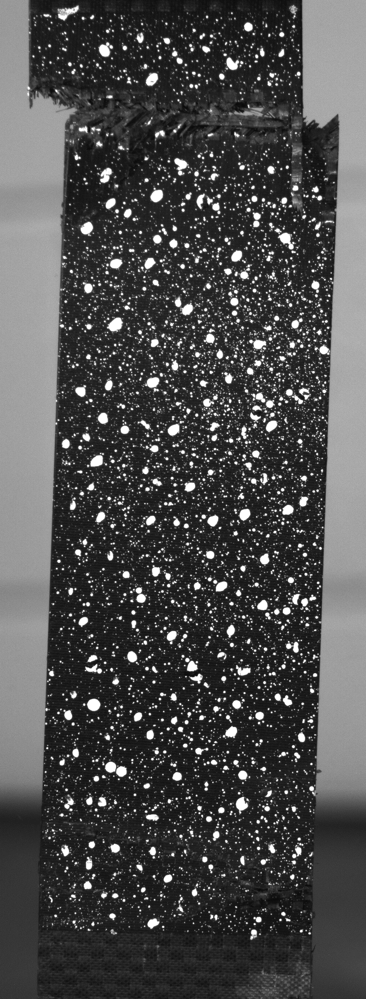
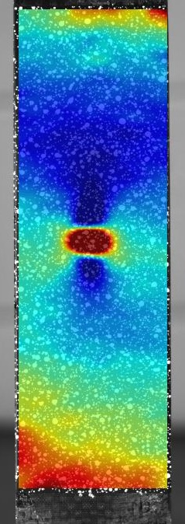
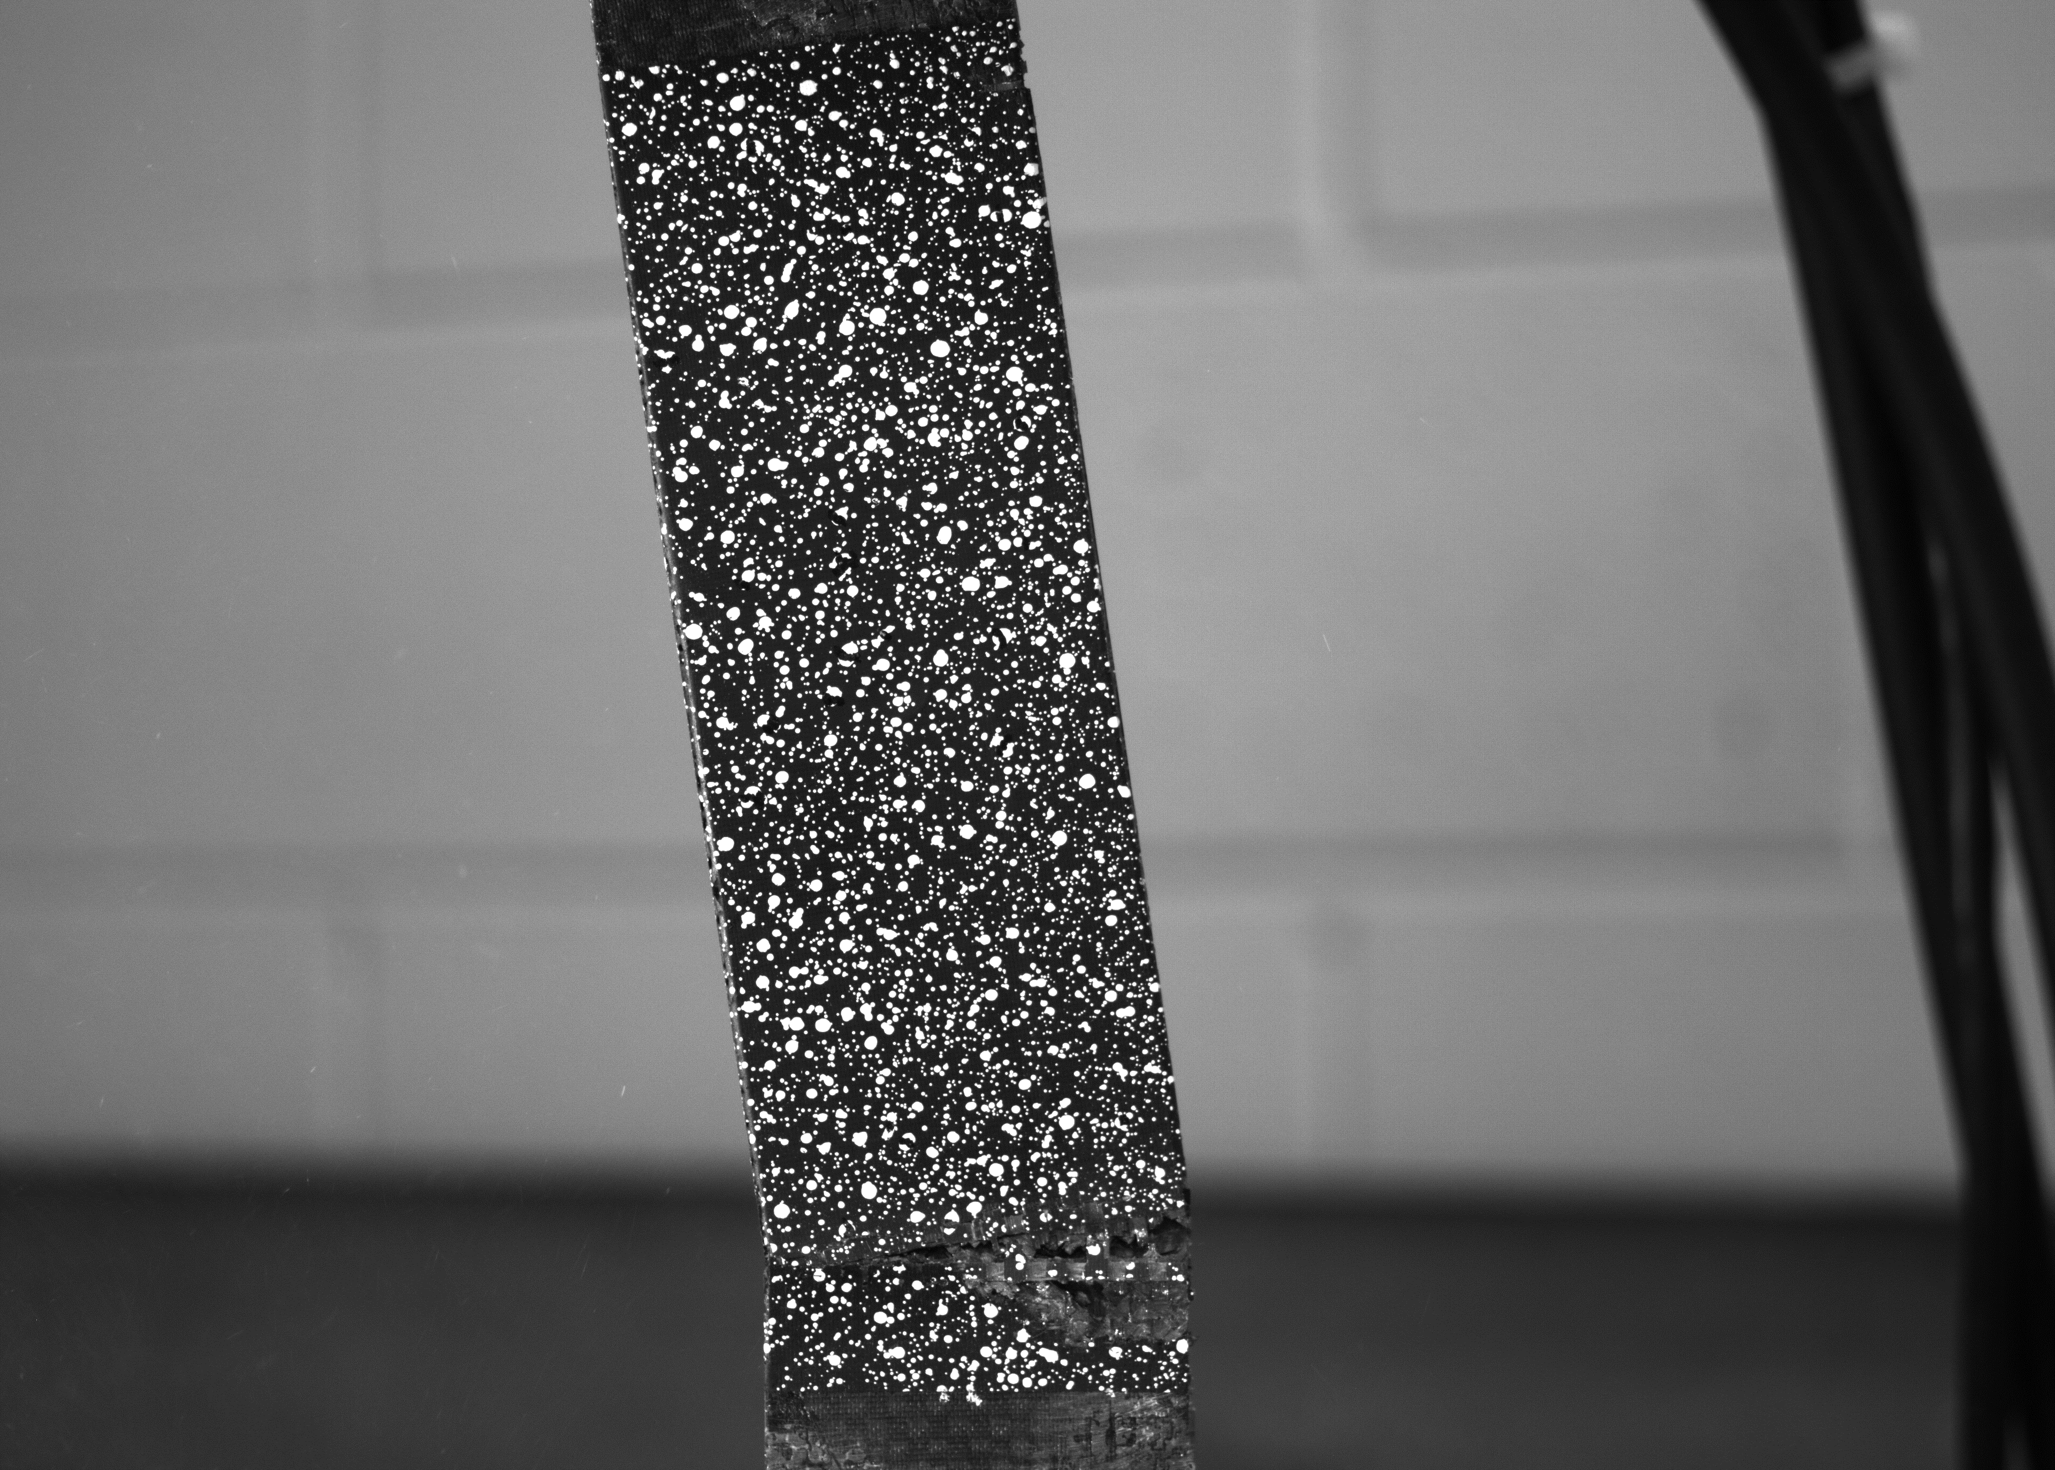
DIC Results (2/2)
Pristine Sample
Repaired Sample
Failure at 13,654 lb_{f} (applied load)
Failure at 13,667 lb_{f} (applied load)
Notes:
Pristine (no pre-damages): DIC matches where it failed
Cracked: identifies high strain where the hole was filled with epoxy. Also identifies high strain where the sample broke
All repaired samples broke where the edge of the repair met the sample. This is because the cross sectional thickness changes and causes the applied load to change directions

Slide 10
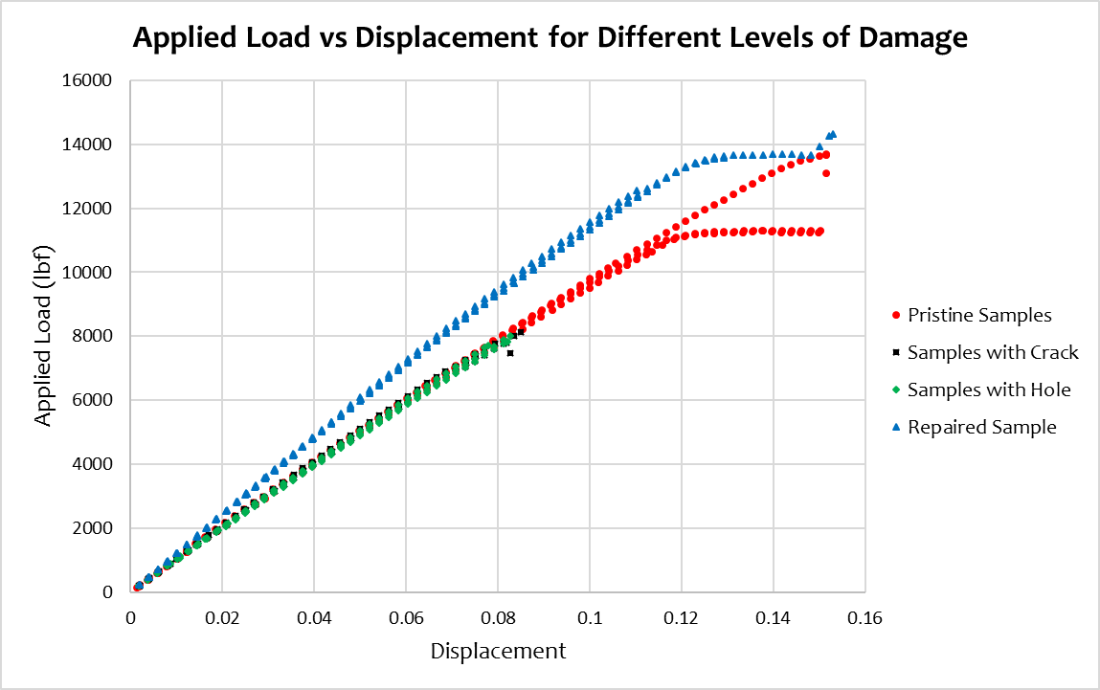
Strength Results
Group | Failure Strength (lb_{f})
Pristine Sample 1 | 13,102
Pristine Sample 2 | 13,697
Pristine Sample 3 | 13,653
Cracked Sample 1 | 7,477
Cracked Sample 2 | 7,809
Cracked Sample 3 | 8,124
Hole Sample 1 | 7,821
Hole Sample 2 | 7,712
Hole Sample 3 | 8,014
Repaired Sample 1 | 12,564
Repaired Sample 2 | 13,570
Repaired Sample 3 | 14,336
Notes:
Less than 1% difference between the average strength of the pristine and repaired samples
1% difference between the average strength of the cracked and holed samples

Slide 11
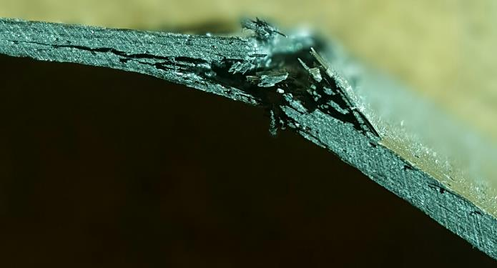
Summary
The repaired samples can withstand applied load equivalent to that of the samples with no damage.
Samples with an equal sized crack and hole exhibit a similar stress distribution trend and have a comparable failure load.
Future works:
  Study different repair methods on composites
  Compare with the simulation or analytical results
Notes:
Establish better understanding of failure mechanisms.

Slide 12


Acknowledgement
NASA Space Grant Arizona Undergraduate Research Internship
Dr. Wahyu Lestari
Greg Mellema
Greg Kress

Slide 13
Thank You!

Slide 14
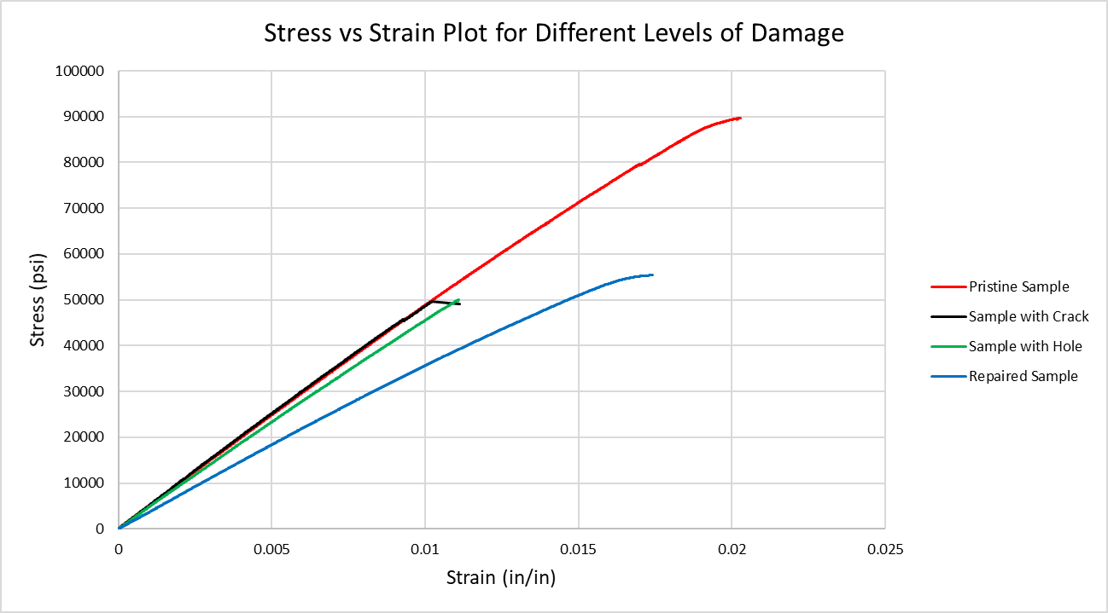
Stress & Strain Results
Notes:
Although the pristine and repaired samples withstood the same amount of applied load, the ultimate tensile strength of the repaired CFRP samples is only 62% of the pristine ones
Strength of the damaged samples is 55% of the pristine
The ultimate tensile strength of the damaged sample is 93% of the repaired sample.

Slide 15
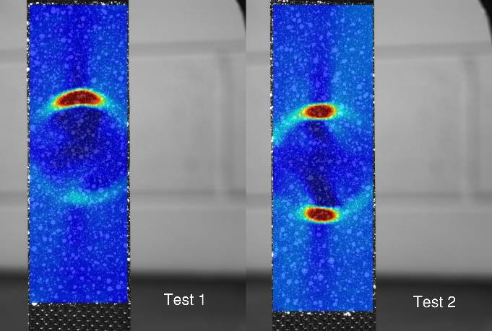
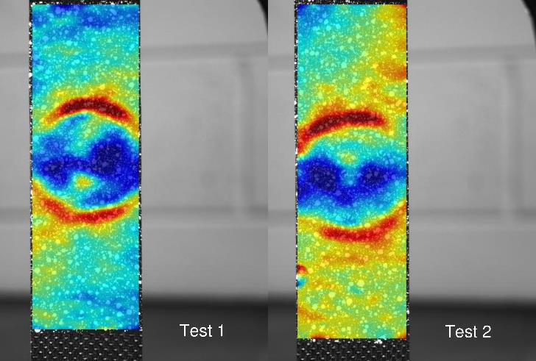
Note on DIC
Beginning of Test
Final DIC Results
Notes:
Ideally for the repair, would have 5 patches on one side of the sample and 5 on the other for more strength. However, the slight protrusion caused by the patches affected the DIC results.
Needs 3D DIC with 2 cameras

